Slide 1





6 Advanced Data Transformation
Prepared By :
Said Fawzy
Manager of Information Center
Tendering Department
Arab Contractors

Slide 2

6 Advanced Data Transformation
Prepared By :
Said Fawzy
Manager of Information Center
Tendering Department
Arab Contractors

Slide 3

1
The Importance of data combination .
2
What is a Joint
3
Join Types
4
Pivot and Unpivot

Slide 4
5
Append Tables.

Slide 5
1
The Importance of data combination

Slide 6
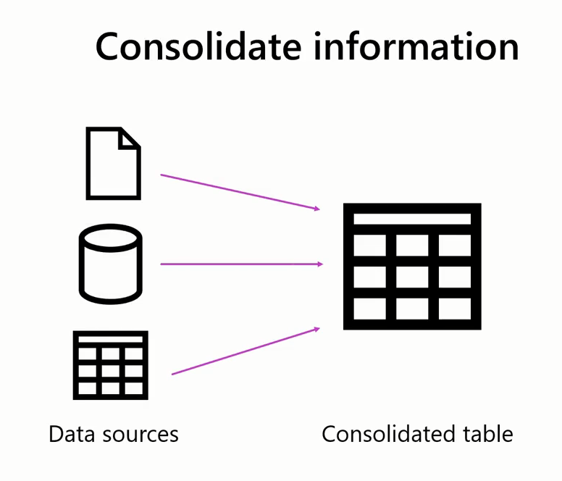
The Importance of data combination

Slide 7


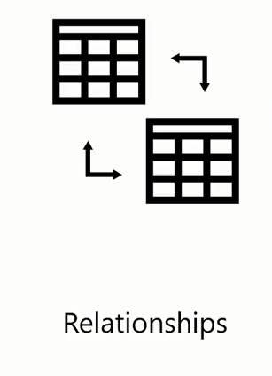

The Importance of data combination

Slide 8
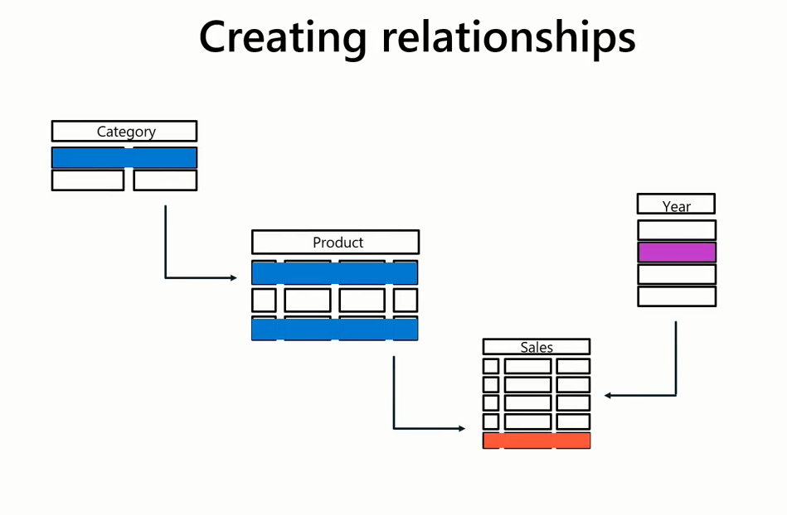
The Importance of data combination

Slide 9


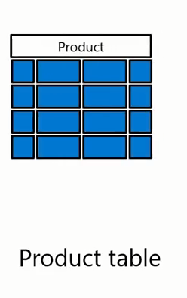
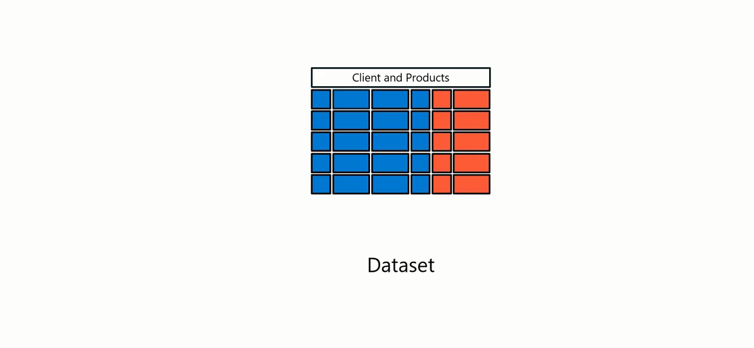
The Importance of data combination

Slide 10
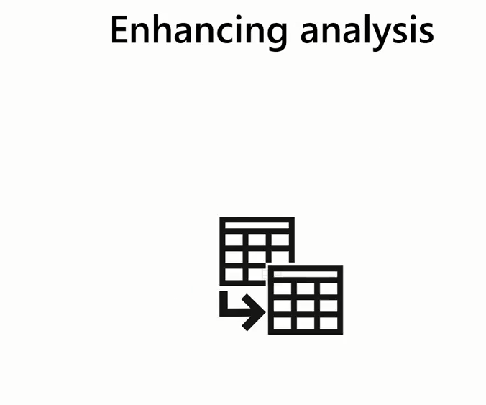

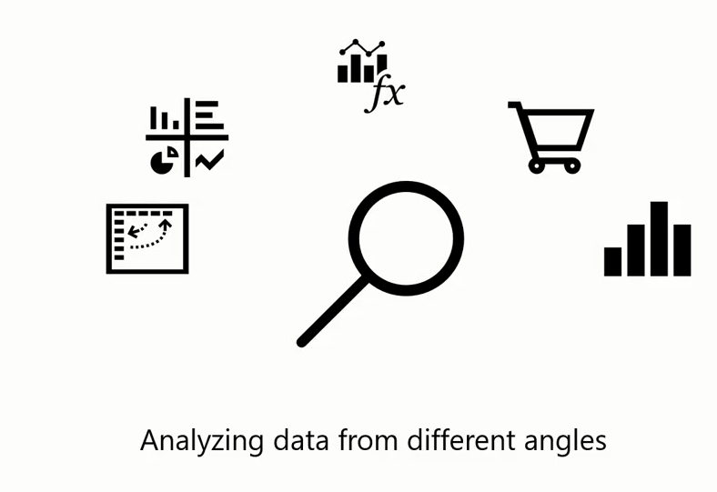
The Importance of data combination

Slide 11


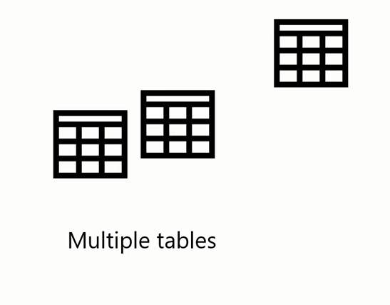




The Importance of data combination

Slide 12


Two Ways to Combine Data

Slide 13
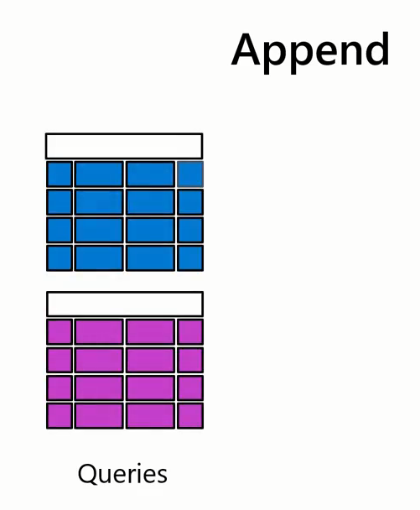

Two Ways to Combine Data

Slide 14


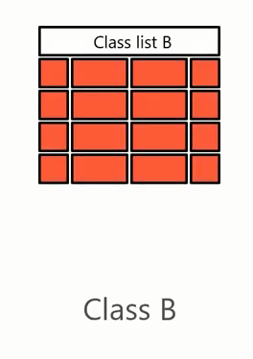
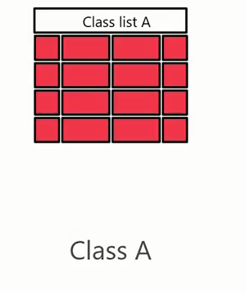
Two Ways to Combine Data

Slide 15



Two Ways to Combine Data

Slide 16
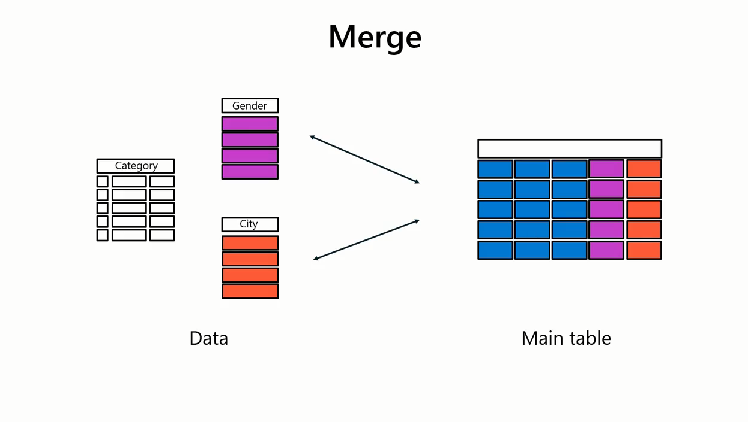
Two Ways to Combine Data

Slide 17
Question
Which one of the following describes the reason for request to combine two different sales datasets together?
A. Enriching data
B. Creating relationships
C. Consolidating information
D. Enhancing analysis

Slide 18
ANSWER
Which one of the following describes the reason for request to combine two different sales datasets together?
A. Enriching data
B. Creating relationships
C. Consolidating information
D. Enhancing analysis

Slide 19
2
What is a Join?

Slide 20






Slide 21
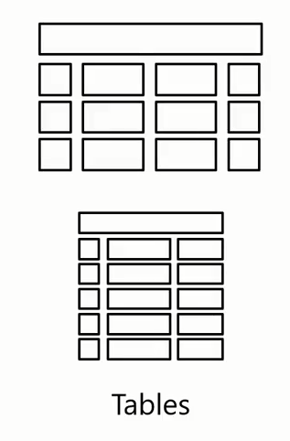




Slide 22
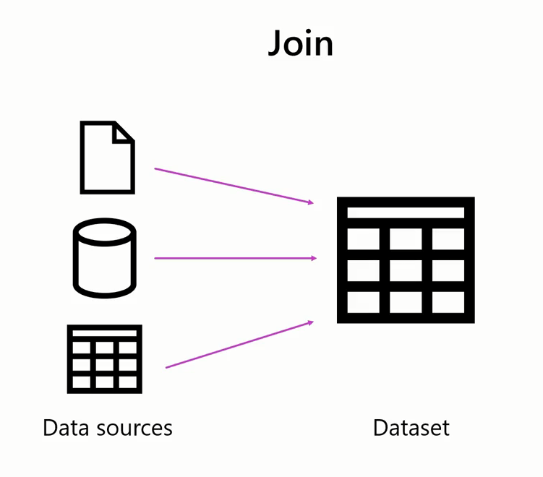

Slide 23
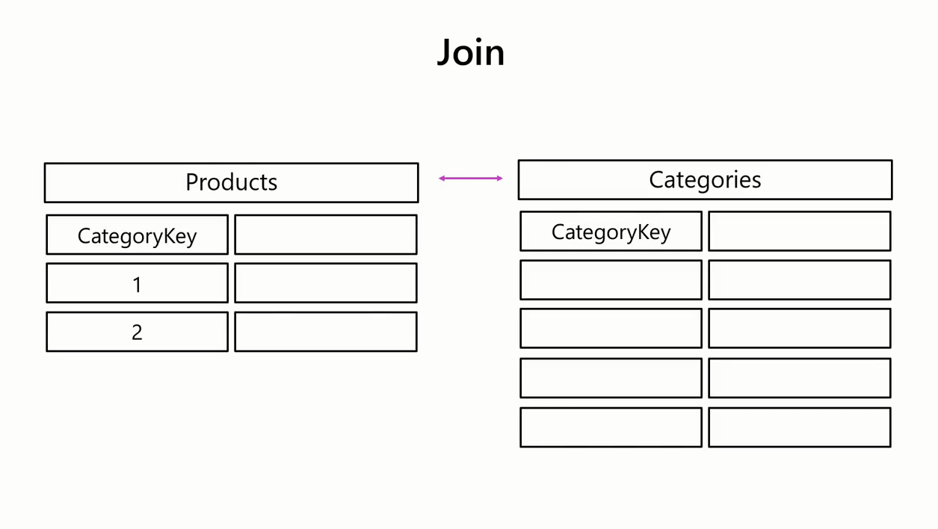

Slide 24
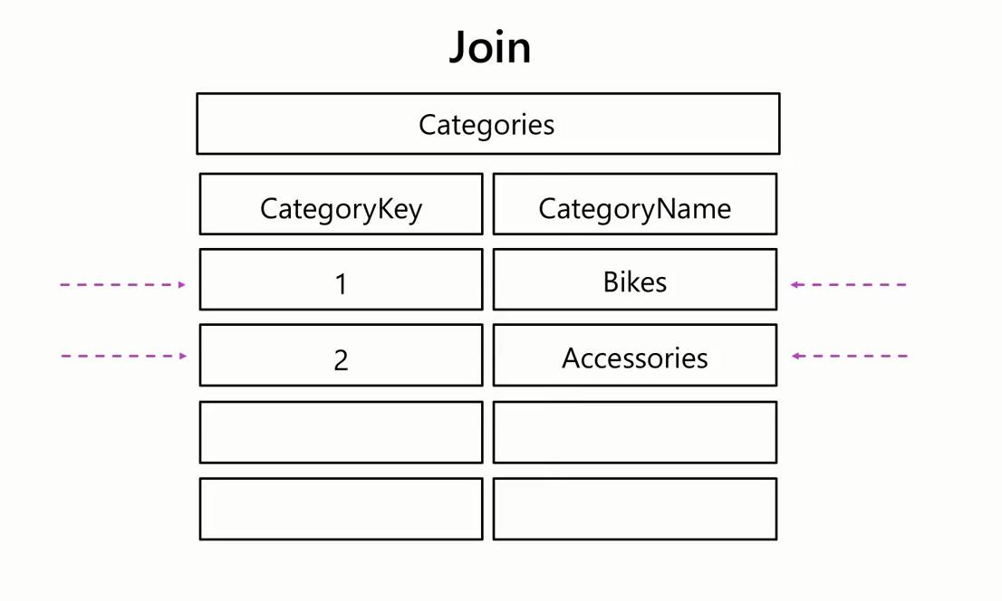

Slide 25
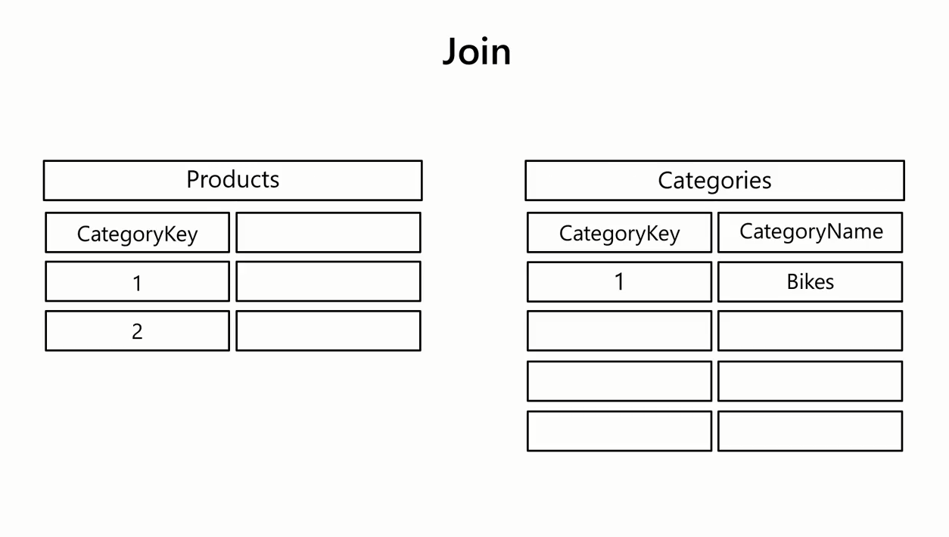

Slide 26
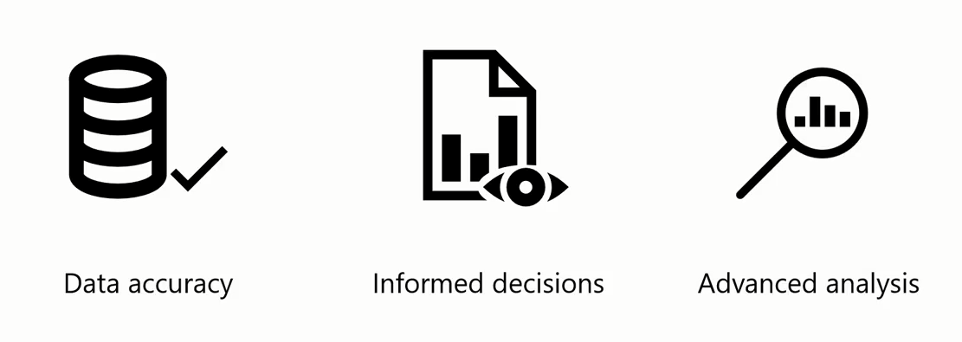
Advanced of Joining Data

Slide 27
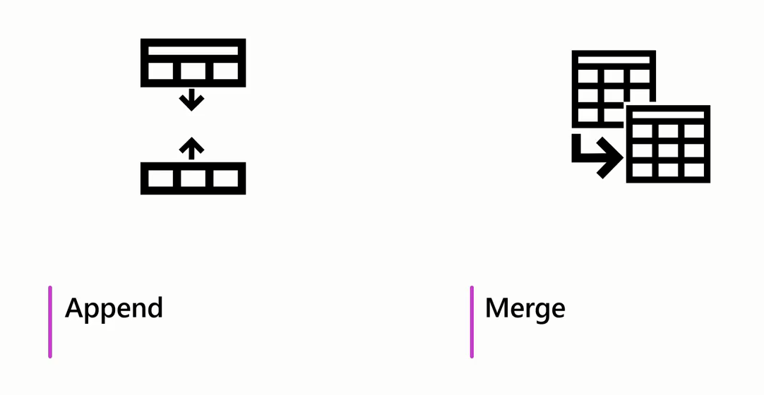

Slide 28

Advanced of Joining Data

Slide 29



Slide 30
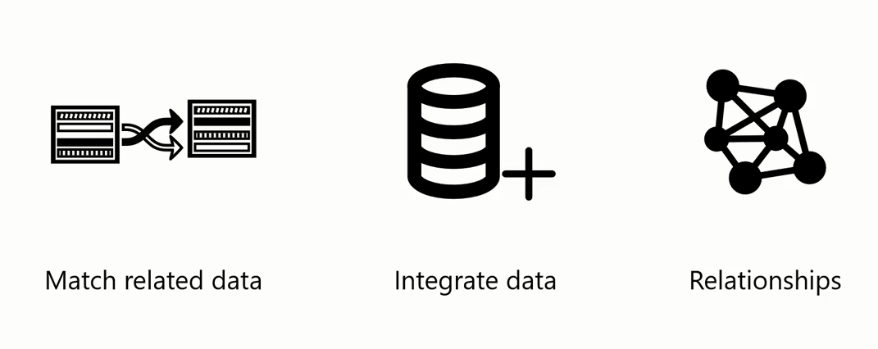
Merge With Join Enables you to:

Slide 31

Merge With Join Enables you to:

Slide 32
Question
Which of the following options can be considered as the purposes of join operation? Select all that apply.
A. Integrating data
B. Ensuring consistency
C. Exploring relationships
D. Creating insights from data

Slide 33
ANSWER
Which of the following options can be considered as the purposes of join operation? Select all that apply.
A. Integrating data
B. Ensuring consistency
C. Exploring relationships
D. Creating insights from data
A
B
C

Slide 34
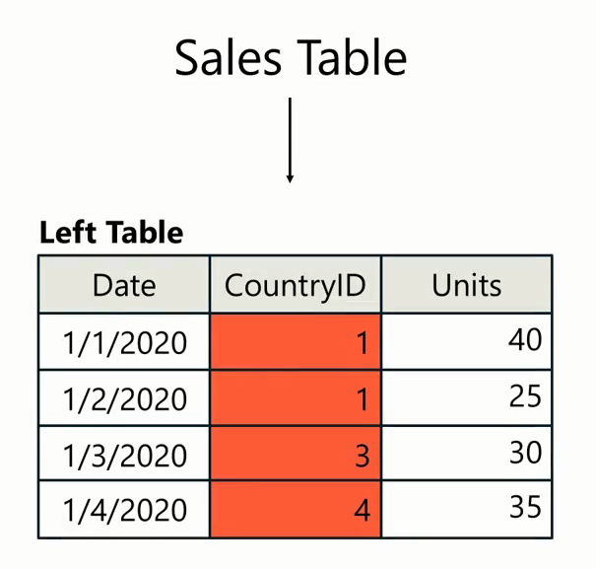
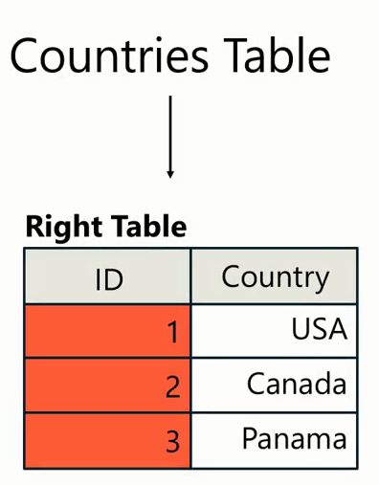
Join keys

Slide 35

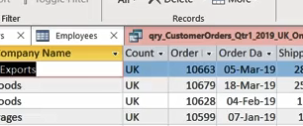
Exercise 13: Merging Queries

Slide 36
3
Join Types

Slide 37

How table are related

Slide 38

So Important

Slide 39


Slide 41
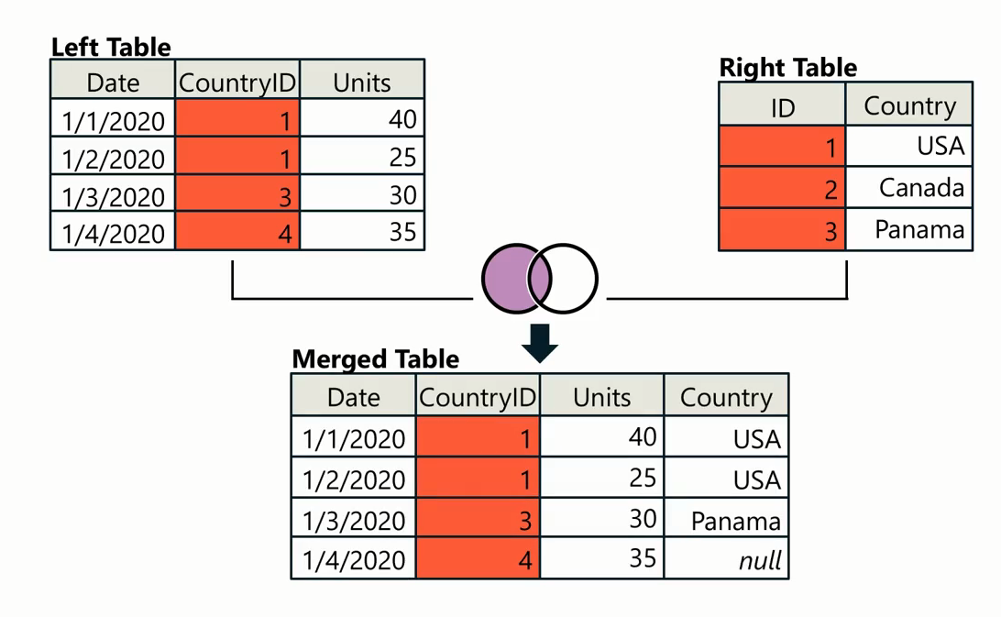


Slide 42


Slide 43
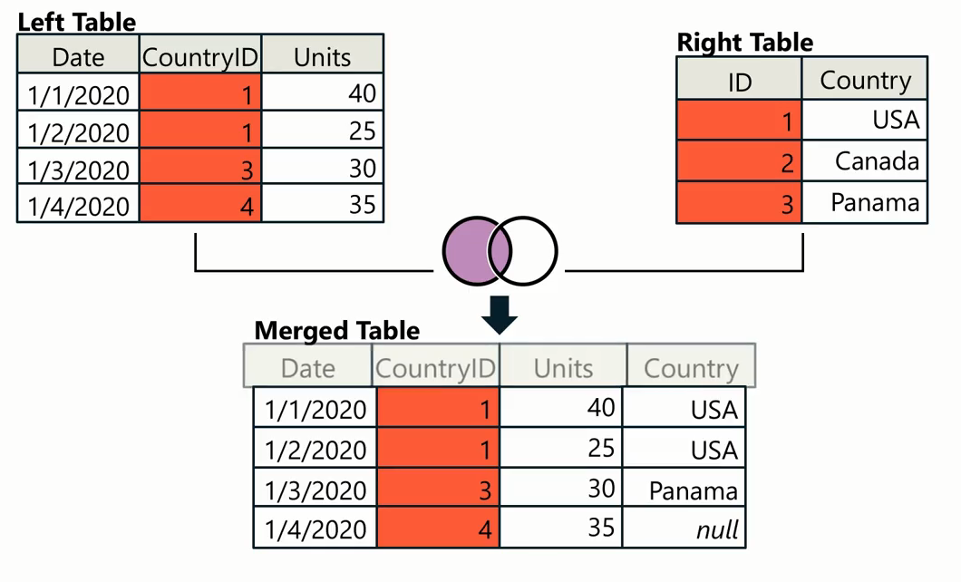

Slide 44



Slide 45
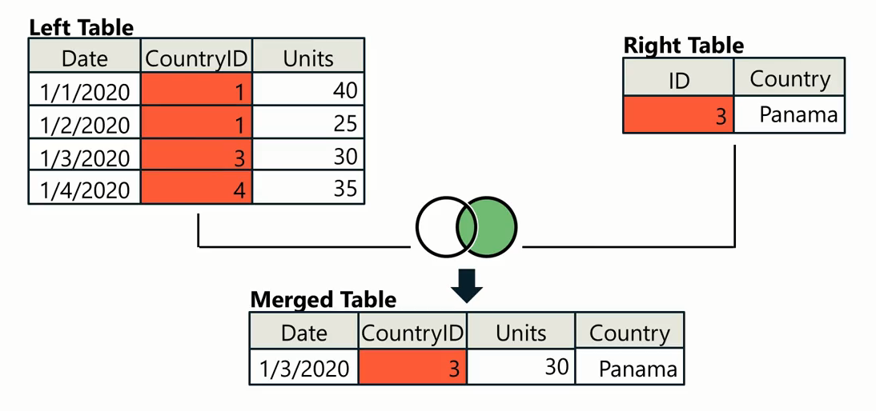

Slide 46
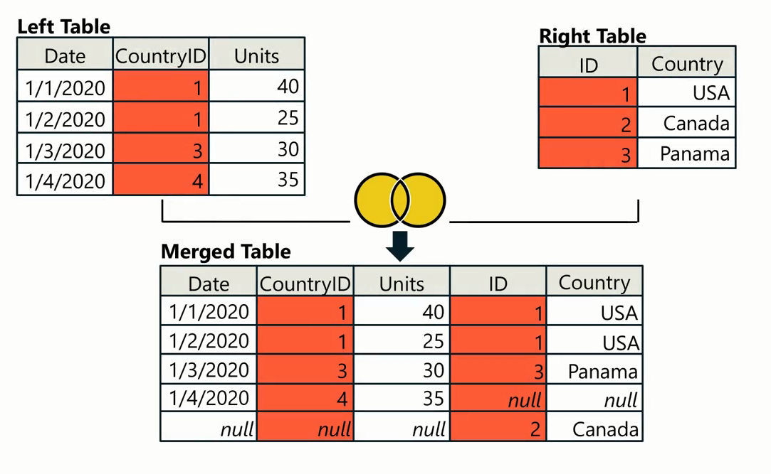


Slide 47
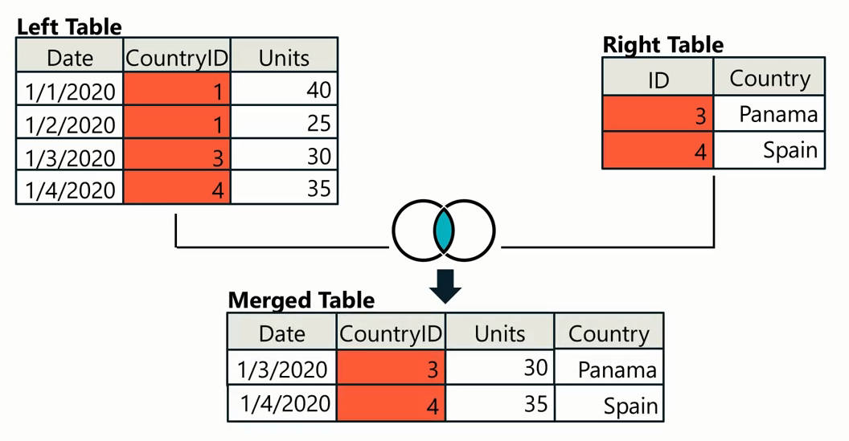


Slide 48


Slide 49
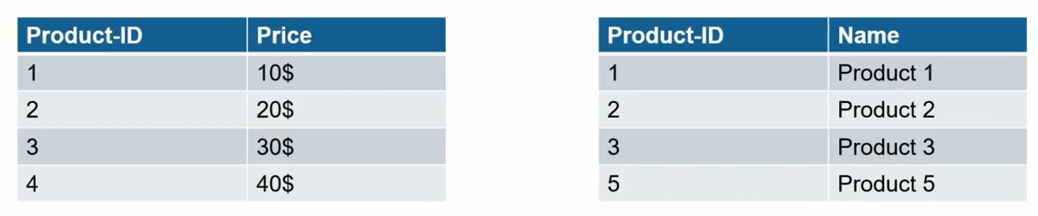

Slide 50
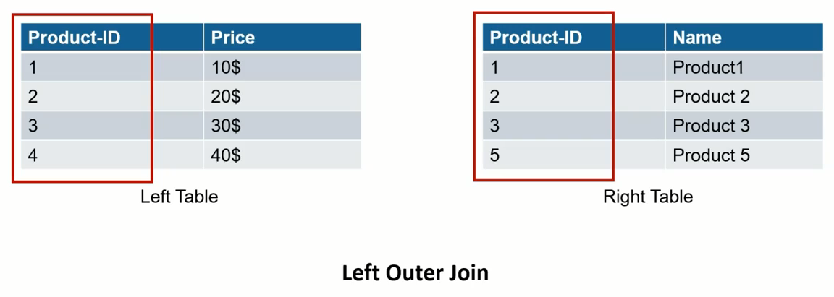
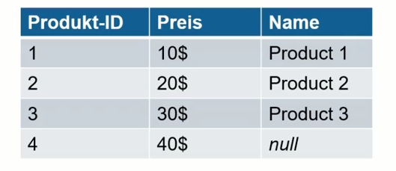

Slide 51
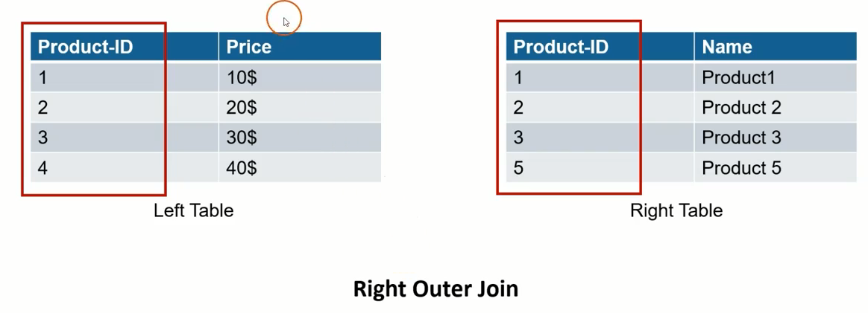
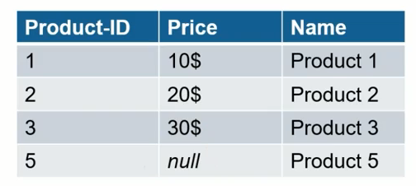

Slide 52
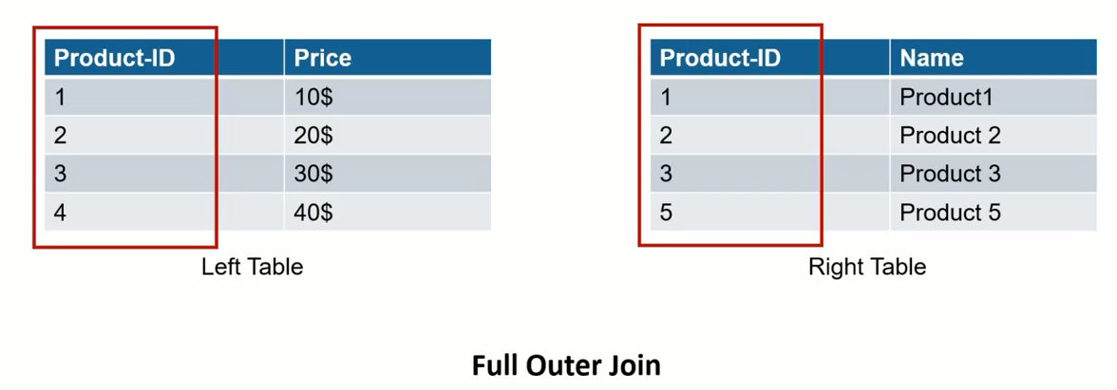
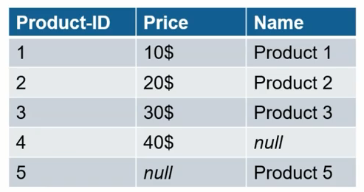

Slide 53
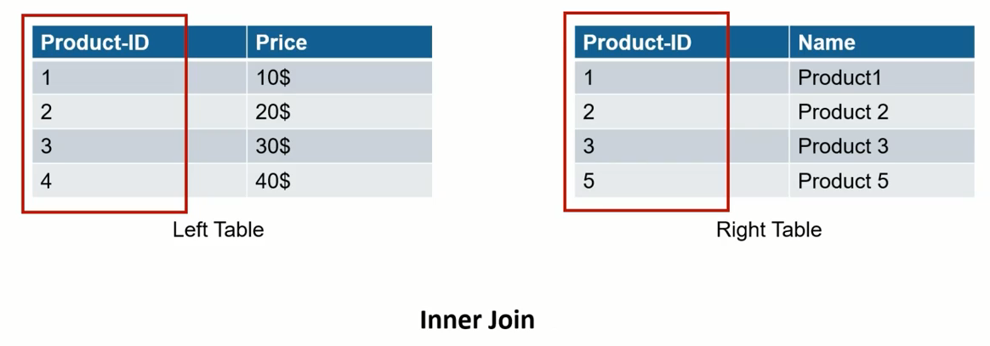
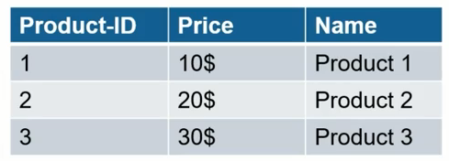

Slide 54
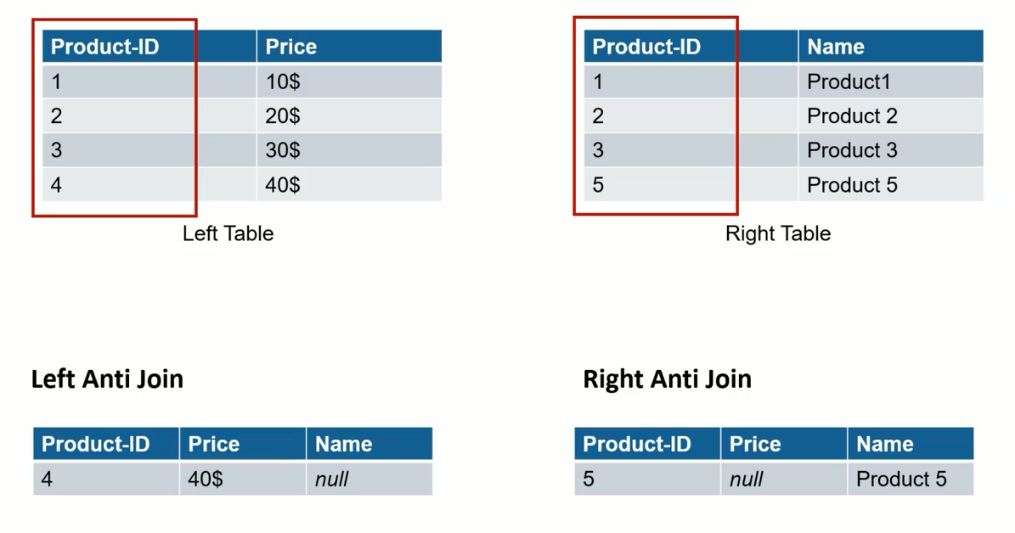

Slide 55
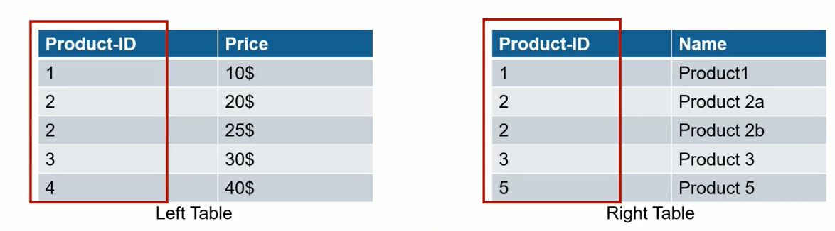
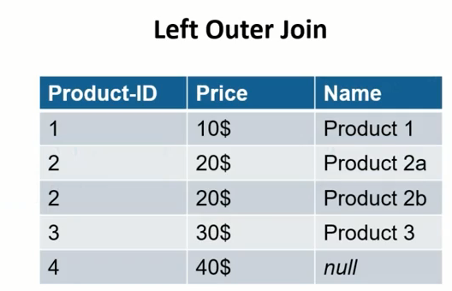
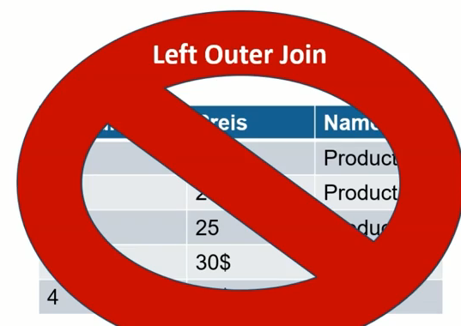
?

Slide 56
Question
Which type of JOIN operation includes only the matching records from both joined tables?
Select the correct option.
A. INNER JOIN
B. LEFT OUTER JOIN
C. FULL OUTER JOIN

Slide 57
ANSWER
Which type of JOIN operation includes only the matching records from both joined tables?
Select the correct option.
A. INNER JOIN
B. LEFT OUTER JOIN
C. FULL OUTER JOIN

Slide 58
4
Pivot and Unpivot

Slide 59

Unpivot and pivot operations are data transformation techniques that you can use to reshape and restructure data

Slide 60

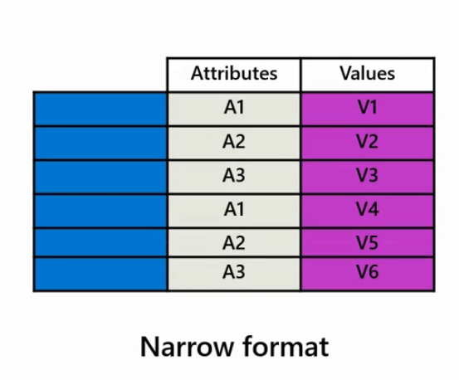
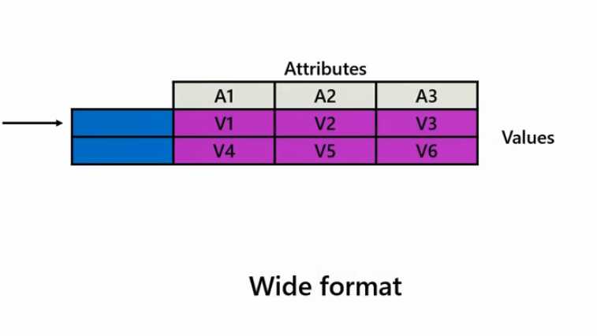
the pivot operation refers to the transformation of data from a narrow format with fewer columns to a wide format with multiple columns by reorganizing the data structure

Slide 61
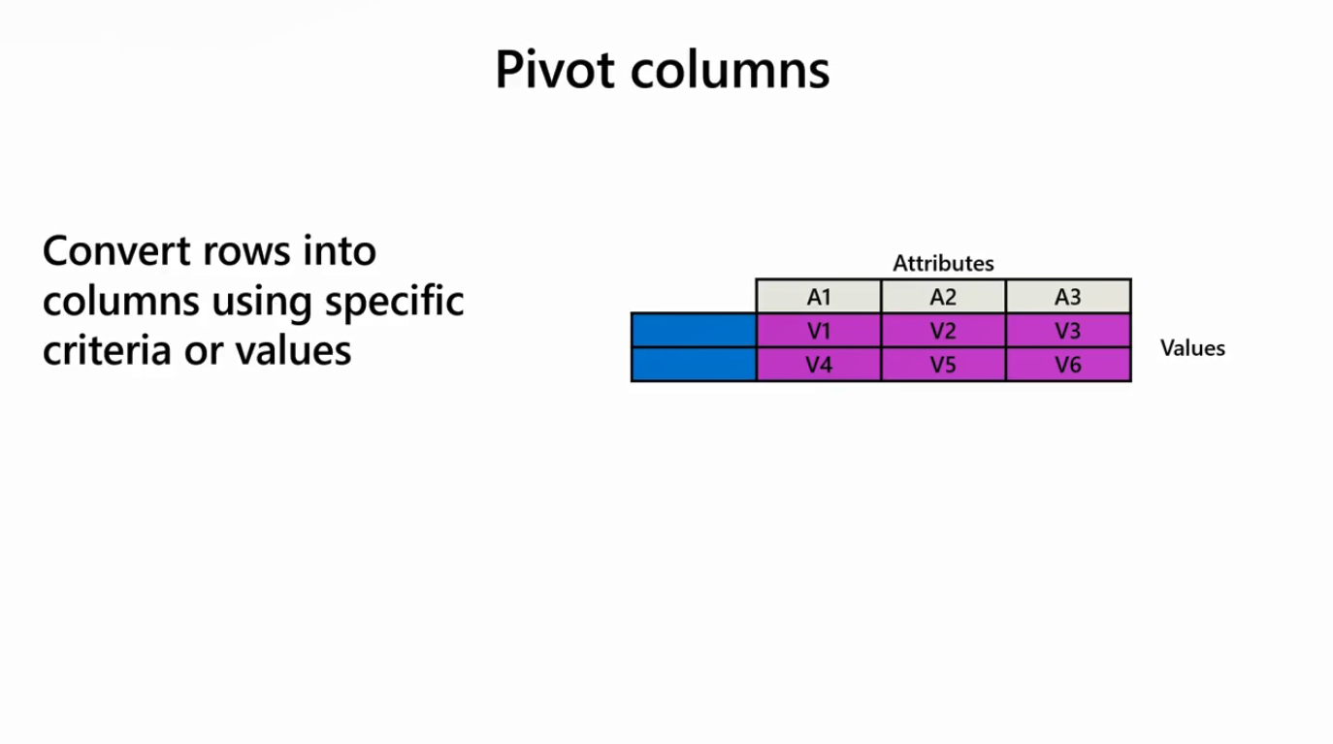
It enables data analysts to convert rows into columns based on specific criteria or values

Slide 62
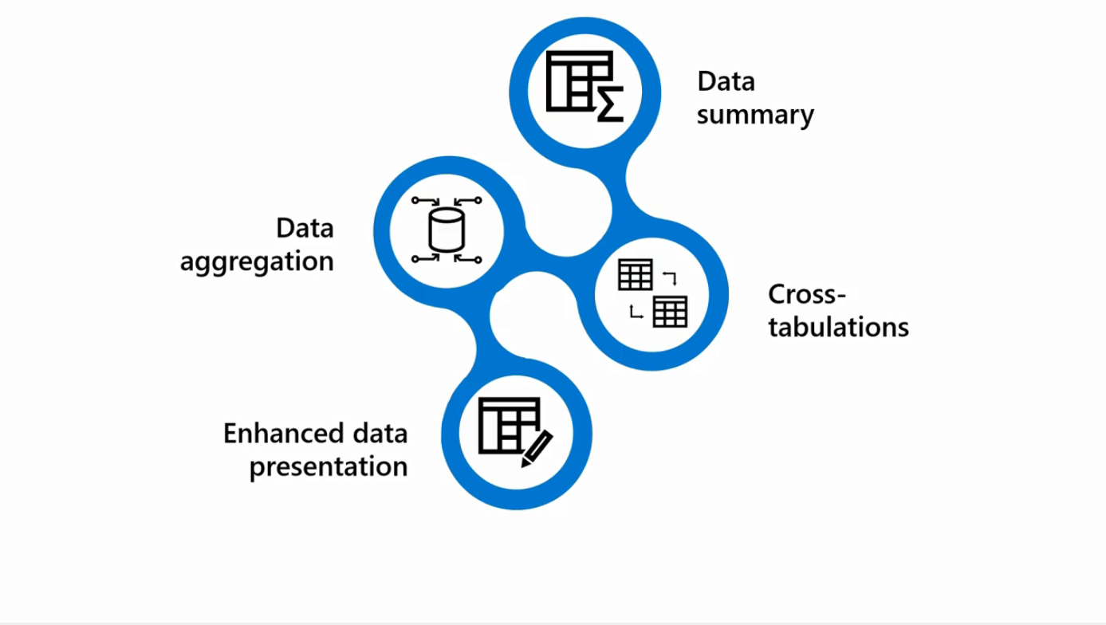
This operation is often used to summarize and aggregate data, create cross-tabulations, and represent data in a more structured easy-to-understand way for analysis and reporting

Slide 63
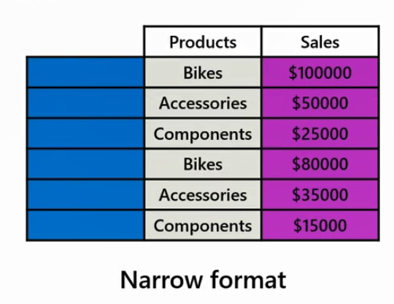
Example
say you want to analyze the sales data based on different product categories as part of the sales analysis

Slide 64
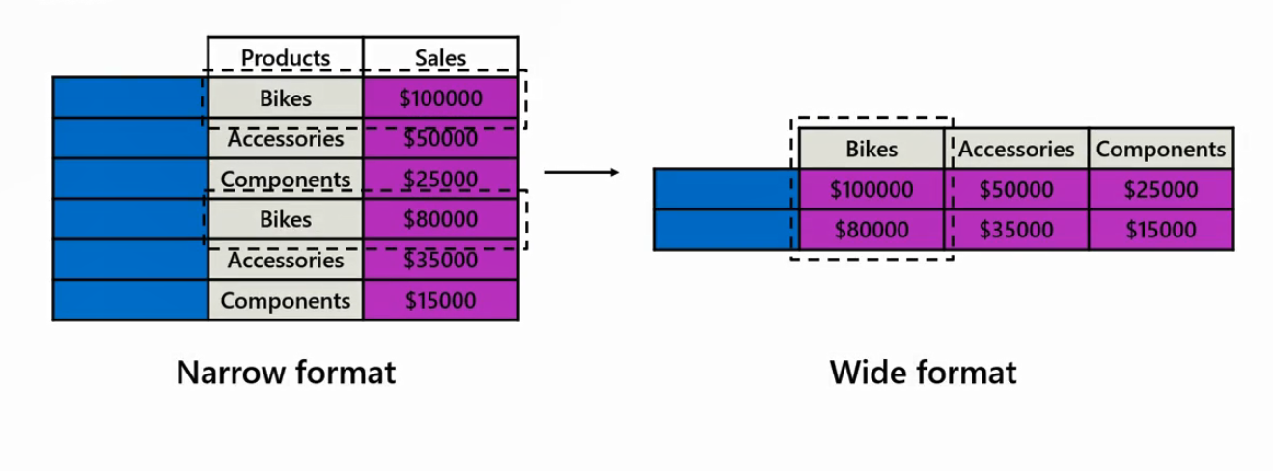
you can transform the rows containing individual product categories into separate columns.

Slide 65
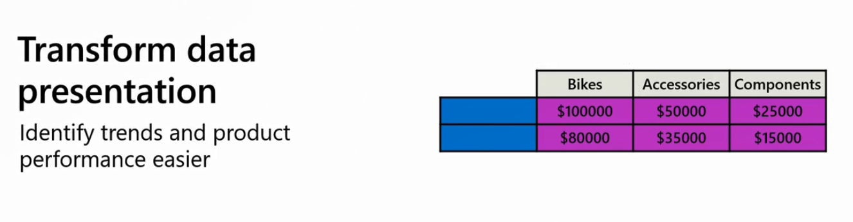
This pivot operation enables you to present the sales data in a more concise and structured manner, making it easier to identify trends, top-selling products, and performance within each category

Slide 66
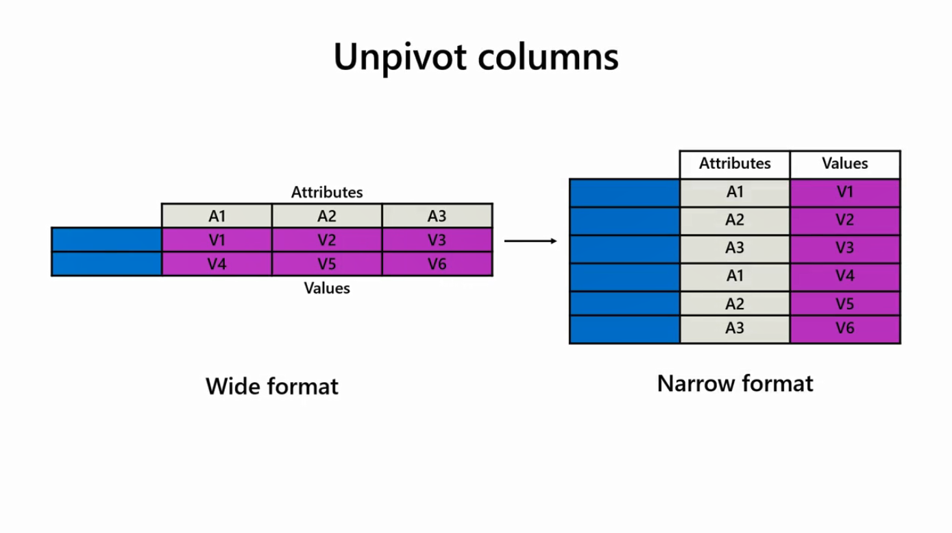
The unpivot operation refers to the transformation of data from a wide format with multiple columns to a narrow format with fewer columns by reshaping the data structure

Slide 67
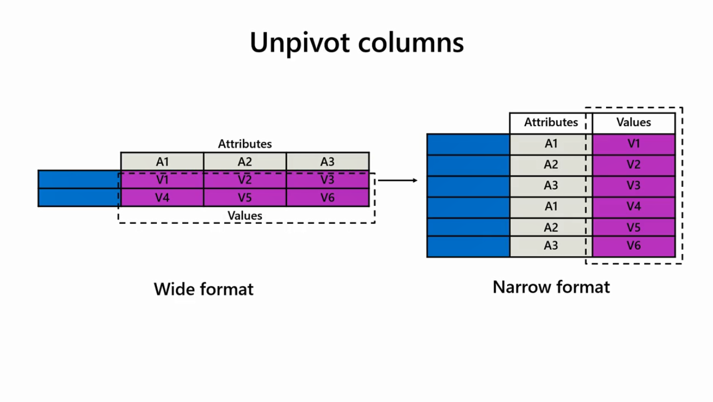
It involves converting column headers into row values resulting in a more structured and standardized representation of the data

Slide 68

The unpivot operation is useful in data analysis supporting data normalization by organizing data in a tabular format

Slide 69



This facilitates analysis, variable comparison, and data aggregation and summary as related information is consolidated into a single column

Slide 70

Transforming data from a wide to a narrow structure can also enable data compatibility and integration with other systems or tools that require a narrow format

Slide 71



Example
you can perform the unpivot operation to convert the sales data, which is organized in a wide format with separate columns for each region into a long format where the region-specific data is stacked vertically in a single column

Slide 72
This makes it easier to compare sales across different regions and gain a holistic view of the overall performance

Slide 73
Question
Which of the following statements describes the pivot operation in Power BI? Select all that apply.
A. The pivot operation converts data from a narrow format to a wide format by reorganizing the data structure.
B. The pivot operation is used for data aggregation and summarization by converting rows into columns.
C. The pivot operation supports data normalization by converting column headers into row values.
D. The pivot operation involves transforming data from a wide format to a narrow format.

Slide 74
ANSWERS
Which of the following statements describes the pivot operation in Power BI? Select all that apply.
A. The pivot operation converts data from a narrow format to a wide format by reorganizing the data structure.
B. The pivot operation is used for data aggregation and summarization by converting rows into columns.
C. The pivot operation supports data normalization by converting column headers into row values.
D. The pivot operation involves transforming data from a wide format to a narrow format.
A
B

Slide 75
Exercise 14: Pivoting and Unpivoting columns

Slide 76
5
Append Tables

Slide 77




Slide 78



Slide 79



Slide 80
Question
Which of the following is the operation of putting two or more tables or queries in one master table together?
A. Appending
B. Merging
C. Combining

Slide 81
ANSWER
Which of the following is the operation of putting two or more tables or queries in one master table together?
A. Appending
B. Merging
C. Combining

Slide 82
Exercise 15: Appending Queries

Slide 83


Slide 84
Question 1
Which feature allows you to combine related data between differently structured data sources in Power Query?
A. Merging
B. Grouping
C. Appending

Slide 85
ANSWER 1
Which feature allows you to combine related data between differently structured data sources in Power Query?
A. Merging
B. Grouping
C. Appending

Slide 86
Question 2
Which of the following can be considered as a purpose of merging data with joins? Select all that apply:
A. Exploring Relationships
B. Expanding Data
C. Integrating Data
D. Matching Related Data

Slide 87
ANSWER 2
Which of the following can be considered as a purpose of merging data with joins? Select all that apply:
A. Exploring Relationships
B. Expanding Data
C. Integrating Data
D. Matching Related Data
A
C
D

Slide 88
Question 3
True or False. The full outer join is useful when you want to retrieve all the records from both tables, regardless of whether they have matching values in the join condition.
A. True
B. False

Slide 89
ANSWER 3
True or False. The full outer join is useful when you want to retrieve all the records from both tables, regardless of whether they have matching values in the join condition.
A. True
B. False

Slide 90
Question 4
You import 4 Microsoft Excel tables named Sales, Product, Reseller and Employee into Power Query.
Sales contains the following columns:
• SalesOrderNumber
• OrderDate
• ProductKey
• ResellerKey
• EmployeeKey
• SalesTerritoryKey
• Quantity
• Unit Price
• Sales
• Cost

Slide 91
Question 4 Cont.
Your manager asked you to list Sales data with the descriptive information from the Product, Reseller and Employee tables for the columns which have the suffix “Key”. What should you do to accomplish this task? Select all that apply:
A. Join Sales and Product tables based on the ProductKey column.
B. Merge the Sales table with the Product, Reseller and Employee tables respectively.
C. Join Sales and Reseller tables based on the EmployeeKey column.
D. Check the column types of (ProductKey), (ResellerKey) and (EmployeeKey) in the Sales, Product, Reseller and Employee tables.

Slide 92
ANSWER 4
A. Join Sales and Product tables based on the ProductKey column.
B. Merge the Sales table with the Product, Reseller and Employee tables respectively.
C. Join Sales and Reseller tables based on the EmployeeKey column.
D. Check the column types of (ProductKey), (ResellerKey) and (EmployeeKey) in the Sales, Product, Reseller and Employee tables.
A
D
B

Slide 93
Question 5
You import two Microsoft Excel tables named Product and Categories into Power Query. There are 319 rows in the Product table. Nine of the total rows in the Product table do not have Categories data, so the CategoryKey of these rows has NULL values.
Your manager asked you to list Product data by showing their category names including the rows which have NULL values in CategoryKey column. What should you do to accomplish this task?
Merge Product and Categories tables based on CategoryKey column by choosing Left Outer Join in the join kind dropdown.
Merge Product and Categories tables based on ResellerKey column.
Merge Product and Categories tables based on CategoryKey column by choosing Inner Join in the

Slide 94
ANSWER 5
You import two Microsoft Excel tables named Product and Categories into Power Query. There are 319 rows in the Product table. Nine of the total rows in the Product table do not have Categories data, so the CategoryKey of these rows has NULL values.
Your manager asked you to list Product data by showing their category names including the rows which have NULL values in CategoryKey column. What should you do to accomplish this task?
Merge Product and Categories tables based on CategoryKey column by choosing Left Outer Join in the join kind dropdown.
Merge Product and Categories tables based on ResellerKey column.
Merge Product and Categories tables based on CategoryKey column by choosing Inner Join in the

Slide 95


